Slide 1


National Household Travel Survey (NHTS)
2009 NHTS Briefing
Tianjia Tang, Ph.D., PE
Chief, Travel Monitoring and Surveys Division
Office of Highway Policy Information, Federal Highway Administration
Washington, DC 20590
1

Slide 2
the NHTS…
National Household Travel Survey
a:The NHTS is a national passenger travel behavior study
b: NHTS survey was carried out in 1969, 1977, 1983, 1990, 1995, 2001, and 2009
2
Notes:
The NHTS is the Nation’s inventory of all Travel.

Slide 3
Content of NHTS Content
Travel Behavior
  Purpose
  Mode share distribution
  Travel time, speed, distance,
Descriptive statistics
  Households
  People
  Vehicles
  Trips
3
Notes:
The NHTS gives you a whole basket of variables to examine travel. From descriptive statistics to analyzing travel behavior, the NHTS is indispensable in examining existing conditions, and developing future expectations on how Americans will travel.

Slide 4
State and Local Involvements
2001 – NY,WI, HI, TX, KY
2009 - FL,GA,SC,NC,VA,NY,WI,CA,IN,TN,TX, VT, IA,+ Locals: Piedmont, Cedar Rapids, Omaha, Maricopa, Sioux Falls, Chittenden county, Pima
4
Notes:
Naturally, the applications of NHTS are varied. We often hear terms such as “The NHTS is the ONLY source of data for ----- analysis.” If at the end of this presentation you carry two things they are:
Examine the NHTS if you want to gain a fundamental understanding on almost any aspect of passenger travel.
Use the NHTS to examine inputs in your local planning applications.
If your state purchased an Add-ON sample to NHTS, the number of applications increase tremendously.

Slide 5
NHTS Geography
National
Individual State
Add on localities
5
Notes:
Naturally, the applications of NHTS are varied. We often hear terms such as “The NHTS is the ONLY source of data for ----- analysis.” If at the end of this presentation you carry two things they are:
Examine the NHTS if you want to gain a fundamental understanding on almost any aspect of passenger travel.
Use the NHTS to examine inputs in your local planning applications.
If your state purchased an Add-ON sample to NHTS, the number of applications increase tremendously.

Slide 6
2009 NHTS
National data was released in January 2010.
Data for all add-on localities had been delivered by the end of February 2010.
6
Notes:
Naturally, the applications of NHTS are varied. We often hear terms such as “The NHTS is the ONLY source of data for ----- analysis.” If at the end of this presentation you carry two things they are:
Examine the NHTS if you want to gain a fundamental understanding on almost any aspect of passenger travel.
Use the NHTS to examine inputs in your local planning applications.
If your state purchased an Add-ON sample to NHTS, the number of applications increase tremendously.

Slide 7
2009 NHTS Web Usage
Key Web site statistics for February, 2010
3,758 unique visitors
5,892 visits
58,497 page views
Table Designer page: 5,237 views
Download page: 2,017 views
Publications page: 1,902 views
7
Notes:
Naturally, the applications of NHTS are varied. We often hear terms such as “The NHTS is the ONLY source of data for ----- analysis.” If at the end of this presentation you carry two things they are:
Examine the NHTS if you want to gain a fundamental understanding on almost any aspect of passenger travel.
Use the NHTS to examine inputs in your local planning applications.
If your state purchased an Add-ON sample to NHTS, the number of applications increase tremendously.

Slide 8
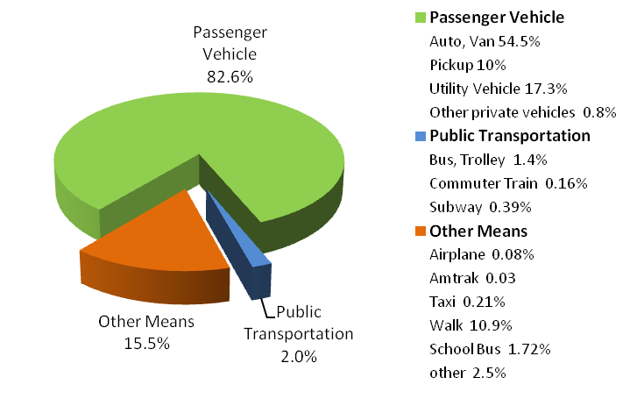
2009 NHTS Modal Share
8
Notes:
Naturally, the applications of NHTS are varied. We often hear terms such as “The NHTS is the ONLY source of data for ----- analysis.” If at the end of this presentation you carry two things they are:
Examine the NHTS if you want to gain a fundamental understanding on almost any aspect of passenger travel.
Use the NHTS to examine inputs in your local planning applications.
If your state purchased an Add-ON sample to NHTS, the number of applications increase tremendously.

Slide 9
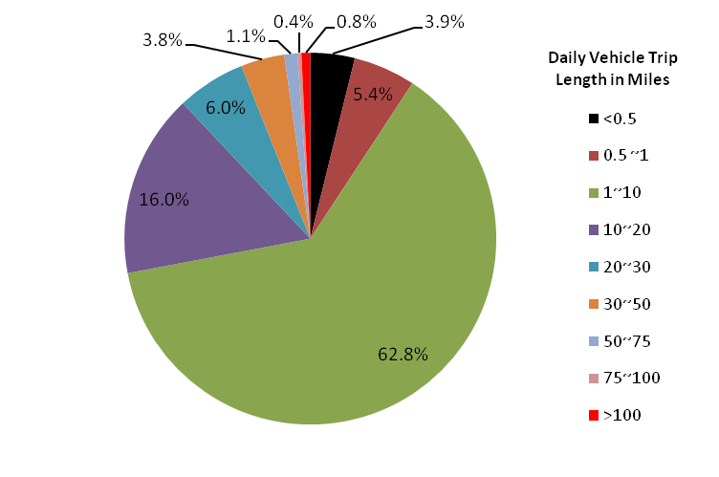
2009 NHTS- Vehicle Trip Length
9
Notes:
Naturally, the applications of NHTS are varied. We often hear terms such as “The NHTS is the ONLY source of data for ----- analysis.” If at the end of this presentation you carry two things they are:
Examine the NHTS if you want to gain a fundamental understanding on almost any aspect of passenger travel.
Use the NHTS to examine inputs in your local planning applications.
If your state purchased an Add-ON sample to NHTS, the number of applications increase tremendously.

Slide 10
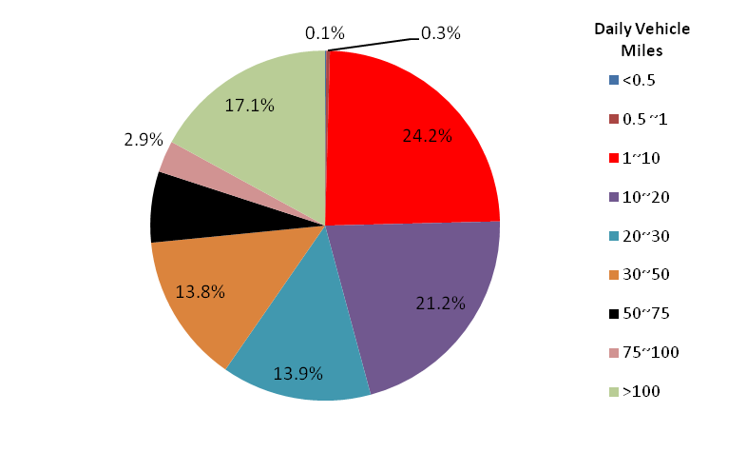
2009 NHTS- Daily Vehicle Miles
10
Notes:
Naturally, the applications of NHTS are varied. We often hear terms such as “The NHTS is the ONLY source of data for ----- analysis.” If at the end of this presentation you carry two things they are:
Examine the NHTS if you want to gain a fundamental understanding on almost any aspect of passenger travel.
Use the NHTS to examine inputs in your local planning applications.
If your state purchased an Add-ON sample to NHTS, the number of applications increase tremendously.

Slide 11
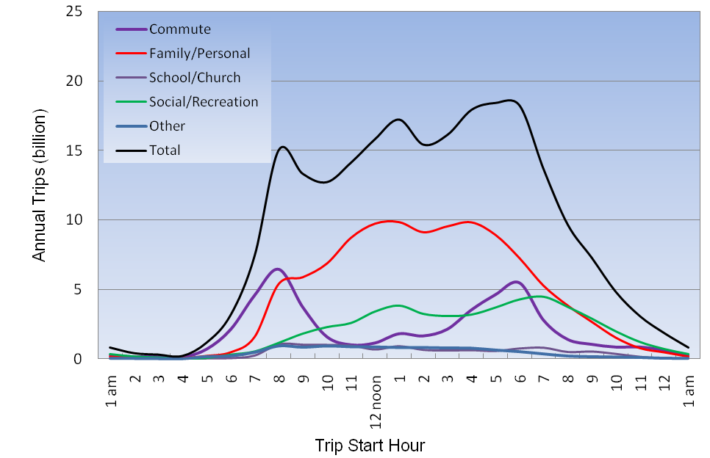
2009 NHTS- Trip by Purpose and TST
11
Notes:
Naturally, the applications of NHTS are varied. We often hear terms such as “The NHTS is the ONLY source of data for ----- analysis.” If at the end of this presentation you carry two things they are:
Examine the NHTS if you want to gain a fundamental understanding on almost any aspect of passenger travel.
Use the NHTS to examine inputs in your local planning applications.
If your state purchased an Add-ON sample to NHTS, the number of applications increase tremendously.

Slide 12
NHTS Applications
Travel demand modeling
Transportation conformity analysis
Safety
Performance measurements
Special studies
Others
http://nhts.ornl.gov/usersAndUses.shtml
12
Notes:
I will now highlight some current and future uses of NHTS at the state level.

Slide 13
NHTS Applications
Travel demand modeling
Transportation conformity analysis
Safety
Performance measurements
Special studies
Others
Cause-Effect Studies and Trend Evaluation
http://nhts.ornl.gov/usersAndUses.shtml
13
Notes:
I will now highlight some current and future uses of NHTS at the state level.

Slide 14
Questions and Answers
Tianjia Tang, Ph.D., PE
FHWA, US DOT
Nancy Mcguckin
Travel Behavior Analyst, Independent Consultant
FHWA NHTS Technical Support
14

